Slide 1

Halving even numbers to 10
Complete the questions on each slide.
To help you see the number fact, separate the tens frame into 2 equal parts.
The slides are increasingly challenging. Look for these signposts to see if it is relevant for you.
All year groups
Year
1 onwards
Year
3 onwards
Year
4 onwards

Slide 2



Find half of these numbers to 10.
Remember, you can slide the tens frame apart to find 1 half.

Slide 3
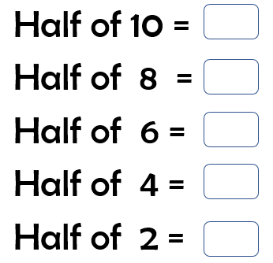

Slide 4

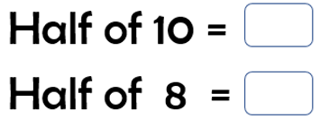

Slide 5

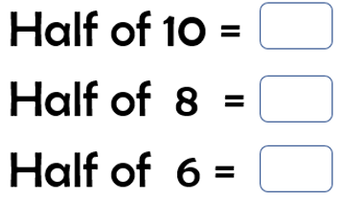

Slide 6

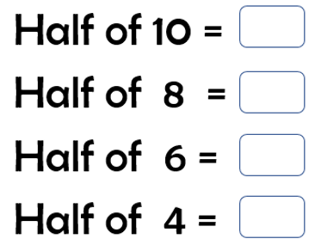

Slide 7


Slide 8

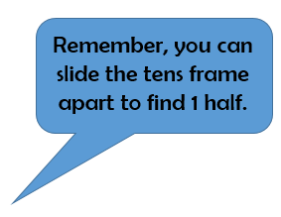

The next set of questions follow the same pattern, but the numbers are 10 times larger.
Each counter now has a value of 10
A full tens frame, now has a value of 100.

Slide 9



Slide 10

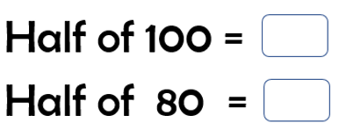

Slide 11

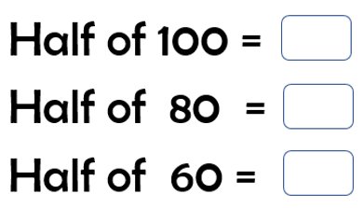

Slide 12

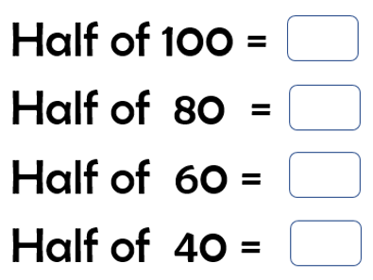

Slide 13

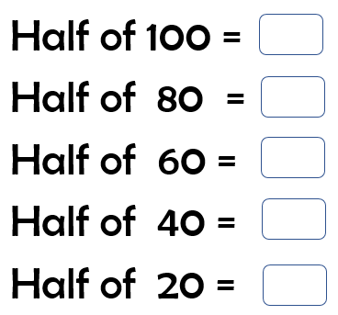

Slide 14

The next set of questions follow the same pattern, but the numbers are 10 times smaller.
Each counter now has a value of 0.1
A full tens frame, now has a value of 1.
0.1

Slide 15



Slide 16

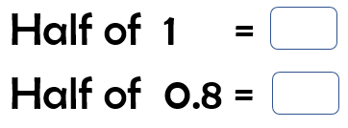

Slide 17
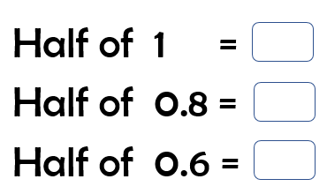


Slide 18

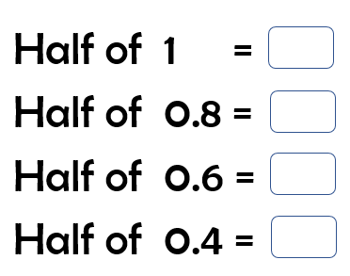

Slide 19

