Slide 1

Adding 7
Complete the questions on each slide.
To help you see the number fact, you can move the blue counters into the tens frames.
The slides are increasingly challenging. Look for these signposts to see if it is relevant for you.
All year groups
Year
1 onwards
Year
3 onwards
Year
4 onwards

Slide 2






Can you find the pairs?
Drag the number together to make 7.

Slide 3
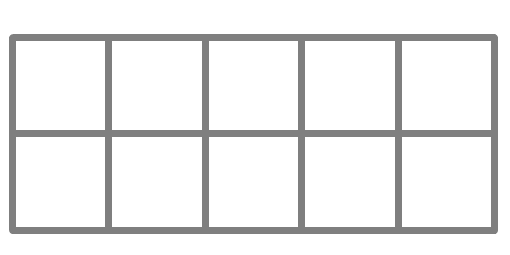
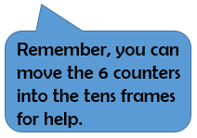

7 + 7 =

Slide 4
9 + 7 =

Slide 5
6 + 7 =

Slide 6
8 + 7 =

Slide 7
5 + 7 =

Slide 8


The next set of questions follow the same pattern, but the numbers are 10 times larger.
Each counter now has a value of 10
When you fill a tens frame, that means, 10 x 10, so a full tens frame has a value of 100.

Slide 9

70 + 70 =

Slide 10
90 + 70 =

Slide 11
80 + 70 =

Slide 12
60 + 70 =

Slide 13
50 + 70 =

Slide 14

The next set of questions follow the same pattern, but the numbers are 10 times larger, again.
Each counter now has a value of 100
When you fill a tens frame, that means, 10 x 100, so a full frame has a value of 1000.

Slide 15


700 + 700 =

Slide 16
900 + 700 =

Slide 17
800 + 700 =

Slide 18
600 + 700 =

Slide 19
500 + 700 =

Slide 20

The next set of questions follow the same pattern, but the numbers are 10 times larger, again.
Each counter now has a value of 0.1
When you fill a frame, that means, 0.1 x 10, so a full frame has a value of 1.

Slide 21


0.7 + 0.7 =

Slide 22
0.9 + 0.7 =

Slide 23
0.8 + 0.7 =

Slide 24
0.6 + 0.7 =

Slide 25
0.5 + 0.7 =

